Slide 1
Building SharePoint Single Page Applications using AngularJS
Steve Pietrek (@spietrek)
https://github.com/spietrek/

Slide 2

Steve Pietrek
Cardinal Solutions Group
App Dev Practice Manager
SharePoint Application Architect
Front End Developer
Raleigh/Durham
Contact
@spietrek
spietrek@cardinalsolutions.com
Presentation References
https://github.com/spietrek/

Slide 3












Thanks to our Sponsors!!!

Slide 4
Session Info
The details can be found through the EventBoard Mobile app – http://app.spsdc.org -> SPSDC

Slide 5
Lanyrd
Only have a web browser?
http://lanyrd.com/2015/spsdc/

Slide 6

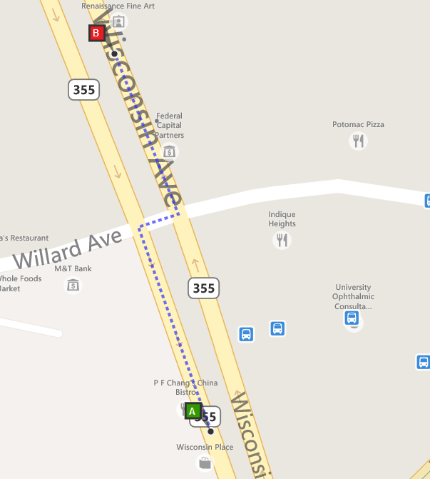

Join us at #SharePint sponsored by K2 at Clyde’s of Chevy Chase in the RaceCar Bar Downstairs
Why? To network with fellow SharePoint professionals
What? SharePint!!!
When? 6:00 PM
Where?
RaceCar Bar Downstairs
5441 Wisconsin Ave
Chevy Chase, MD 20815
Thanks to?
K2!

Slide 7
Agenda
SPA Overview
AngularJS Overview
Tools & Data Access
Projects Demo
Deployment
Best Practices & Gotchas

Slide 8
Single Page Applications

Slide 9
Single Page Applications
Goal:
Provide a desktop-like rich user experience
Attributes:
Entire site content loads within a single HTML page
Only areas of the site will reload based on user actions. No URL change except for hash (#).
State maintained on client
Presentation layer can be completely decoupled from backend layer
Main technologies: HTML, CSS, JavaScript, AJAX, web services (e.g. REST)
Benefits:
Performance
Maintainability (if you leverage a framework or you are a JavaScript ninja developer)
Code reuse
Quick Deployments

Slide 10
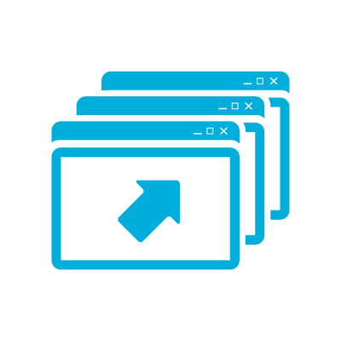
"Traditional" SharePoint Development Challenges
Performance and Stability
Lifecycle Management
Not Cloud Ready
Resources
Notes:
Challenges
Difficultly finding qualified resources
Steep learning curve
Performance and stability issues
Requires deployment by Farm Administrators
Lifecycle management
Not cloud ready
What is a SharePoint 2013 App?
Web application that runs “OUTSIDE” of SharePoint
Uses Client OM to talk to SharePoint (JS, REST/CSOM)
Is the future proof way to add new capabilities to SP2013+
Is available from the Corporate App Catalog or SharePoint Store
Is easy to install by site owners or Tenant/Farm administrators

Slide 11
AngularJS Overview

Slide 12

What's AngularJS?
"Superheroic JavaScript MVW Framework"
Structural JavaScript client-side framework for building dynamic web apps (using HTML and JavaScript)
Empowers traditional HTML
Extend HTML's syntax to express your application's components clearly and succinctly
Backed by Google and the community
Open source (MIT License)
Vibrant community (books, Stack Overflow, blogs, plug-ins, resources, etc.)
** Great framework for building single page applications
** My opinion

Slide 13
Main Features of AngularJS
MV*
Dependency Injection
Testing
jqLite or jQuery
Templates
Modules
Controllers
Filters
Providers
Form Validation
Routing
Two-way Data Binding
Directives

Slide 14
AngularJS Filters
Formats the value of an expression displayed to users
OOTB examples include:
currency, date, filter, json, limitTo, lowercase, number, orderBy, uppercase
Chain multiple filters using |
Create custom ones
Yes, there is a "Filter" Filter
ng-repeat="president in demo.presidents | orderBy:'name'"
ng-repeat="president in demo.presidents | filter:demo.name"
<li ng-repeat="president in demo.presidents | orderBy:'name' | filter:demo.name">
{{president.name | uppercase}}
</li>

Slide 15
AngularJS Providers
Singleton objects
Keep data around for lifetime of application
Separation of concerns
Logical place to access external data ($http or $resource)
Preferred method to communicate between controllers
Yes, there is a "Provider" Provider
Constant
Value injected anywhere
Value
Simple injectable value
Factory
Injectable function
Service
Injectable constructor
Provider
Configurable factory
Notes:
http://blog.xebia.com/2013/09/01/differences-between-providers-in-angularjs/

Slide 16
Implementation of MV* in AngularJS
Browser
User Interaction (Routes & Behaviors)
Controller
(Logic/ Behaviors)
Model
(Provider)
RESTful Web Service
DOM
View
(UI)
$scope

Slide 17
AngularJS Demo https://jsfiddle.net/spietrek/04y3zwo8/3/

Slide 18
AngularJS Directives
Many out-of-box directives (e.g. ng-app, ng-repeat, ng-model, ng-controller, etc.)
Allow you to extend HTML vocabulary for your application
HTML annotations that trigger JavaScript behaviors
Extend attributes, elements, classes, or comments
Function that runs when the compiler encounters it in DOM
DISCLOSURE: Most complex area in AngularJS. Important to learn for code reuse and separation of concerns.

Slide 19
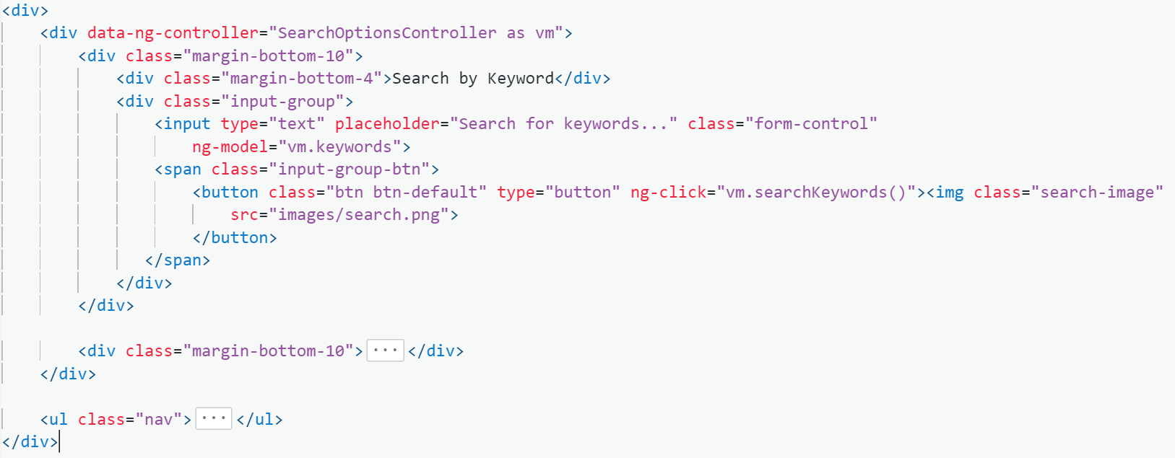

Slide 20
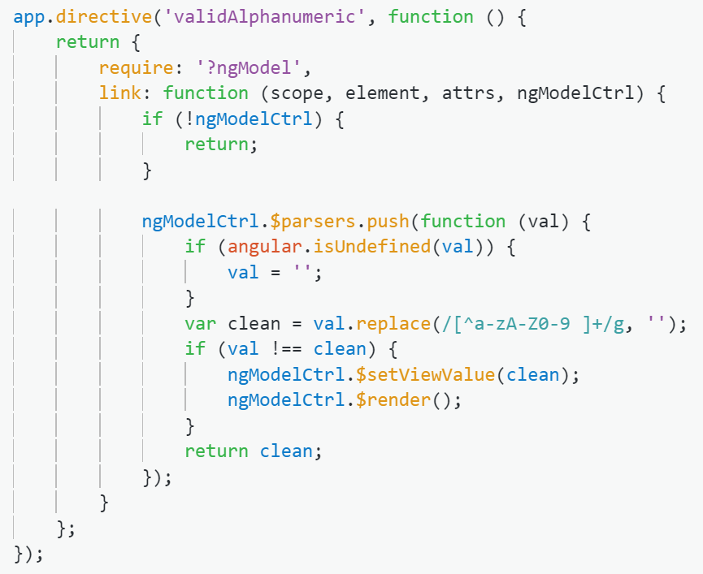

Slide 21
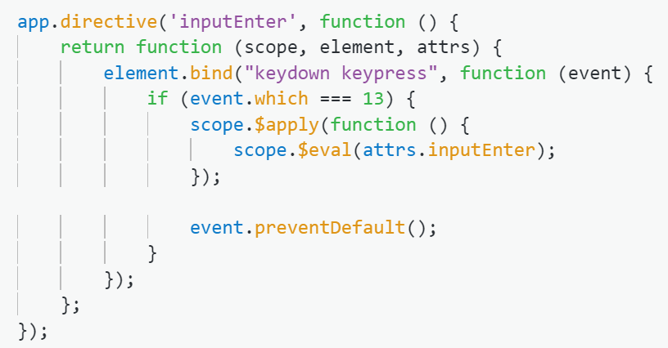

Slide 22
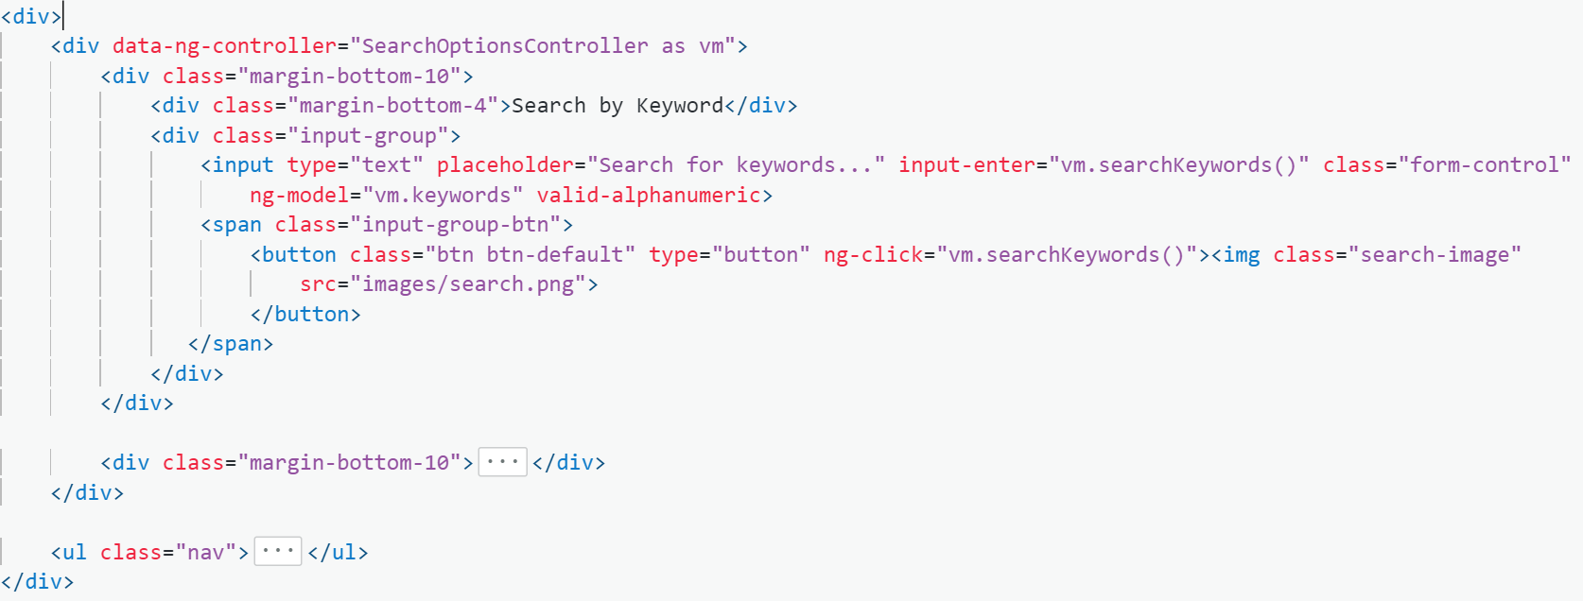

Slide 23
Tools and Data Access

Slide 24
Tools
IDE: Visual Studio, Visual Studio Code, WebStorm, Brackets, Atom, Sublime Text
Third-party JavaScript frameworks: jQuery, Bootstrap, Moment, Globalize, DataTables, ng-tasty, Font Awesome, SPServices, lodash/Underscore
Browser Plug-ins: Firebug, Batarang, Postman
Task Runner: Gulp
Package Manager: npm, Bower
Source control: Git, GitHub, Bitbucket, Visual Studio Online
Other tools: Node.js, Fiddler, Karma, Jasmine, PhantomJS

Slide 25
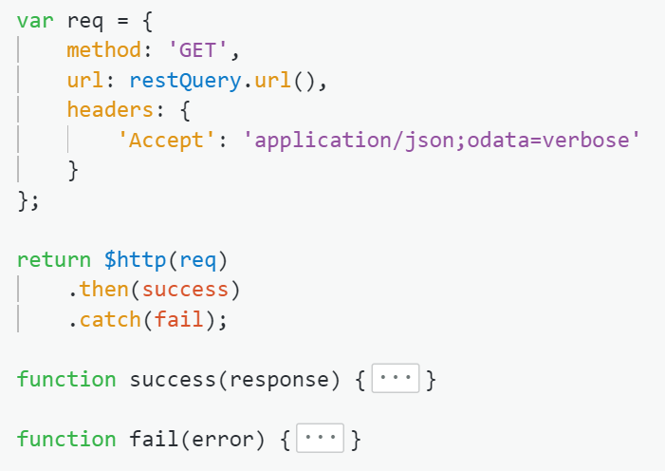
SharePoint 2013 REST
Use jQuery AJAX or AngularJS $http
Options
$select
$filter
$top
$skip
$orderBy
$expand
Best practices
Use Postman or Fiddler to execute and test queries
Set the Accept header
Only retrieve what you need by using $select and $filter.
“Chunky, not chatty”

Slide 26
Projects Demo

Slide 27
Deployment

Slide 28
Deployment Workflow
SharePoint Deployment
Same folder structure as local environment
Upload source code
Local Test
Gulp tasks (test, serve-dev, serve-specs)
Functional testing in Chrome
Disable web security (--disable-web-security) errors in Chrome
Gulp task (build)
Create Custom Page Layout
Enable Publishing features
Style and script references
Base HTML referencing ng-app
Upload to Master Page Gallery
Functional testing in SharePoint
Create page using custom page layout

Slide 29
Best Practices & Gotchas

Slide 30
Best Practices
Organize code: John Papa’s Angular Style Guide http://goo.gl/xljmi6
Group by Feature (Projects, Form, Admin), not component type (e.g. Controller, Directive, Provider)
Name your files by function (e.g. projects, dashboard, admin)
Group all files together (module, controllers, services, directives, unit tests, end-to-end tests)
Only one controller per view. Share data between controllers using services.
Build and deploy often!!!
Learn Git
Write unit tests
Test in different browsers

Slide 31
Gotchas
Issue | Workaround
SharePoint Item-limit Threshold | Split data into separate lists or libraries. Add indexes to columns where you want to filter.
SharePoint Security | Apply security at the site or list levels. If possible, avoid item-level permissions. Use Search API to aggregate across sites and lists.
CSS Overrides | SharePoint default CSS may cause style issues. Deploy to SharePoint and test using different browsers. Update CSS to run the same in local environment.
AngularJS Controller Bloat | Use directives to manipulate DOM. Data should be stored in services.
AngularJS Performance | Avoid 2000 watchers on page (higher in 1.3+). Use Batarang to search for duplication. Use bind once for expressions which do not change.
Dependencies | Review dependencies whenever upgrading tools (npm & bower).
Frameworks | "Framework of the week"

Slide 32
Join us at #SharePint sponsored by K2 at Clyde’s of Chevy Chase in the RaceCar Bar Downstairs
Why? To network with fellow SharePoint professionals
What? SharePint!!!
When? 6:00 PM
Where?
RaceCar Bar Downstairs
5441 Wisconsin Ave
Chevy Chase, MD 20815
Thanks to?
K2!

